Slide 1



Insurance Premium Prediction

Slide 2
Objective
The purposes of this predictive model is to look into different features to observe their relationship, and plot a multiple linear regression based on several features of individual such as age, physical/family condition and location against their existing medical expense to be used for predicting future medical expenses of individuals that help medical insurance to make decision on charging the premium.

Slide 3
Benefits
Personalized Premiums: It allows insurers to offer personalized premiums based on individual risk factors, making insurance more affordable for low-risk individuals.
Risk Management: Insurers can better manage risk by accurately predicting the likelihood of claims, leading to more stable financial planning and reserves.
Customer Satisfaction: Customers receive fairer pricing, which enhances trust and satisfaction with the insurance provider.
Competitive Advantage: Insurers with accurate price prediction models can offer more competitive rates, attracting more customers and increasing market share.
Operational Efficiency: Automating the pricing process reduces manual work, leading to faster policy issuance and lower administrative costs.
Regulatory Compliance: Ensures that pricing strategies comply with regulatory standards by providing transparent and justifiable premium calculations.
Market Insights: Helps insurers understand market trends and customer behavior, enabling them to develop better products and services.

Slide 4
Data Sharing Agreement
Data File (ex insurance.csv)
The insurance.csv dataset contains 1338 observations (rows) and 7 features (columns).
The dataset contains 4 numerical features (age, bmi, children and expenses) and 3 nominal features (sex, smoker and region) that were converted into factors with numerical value designated for each level.

Slide 5
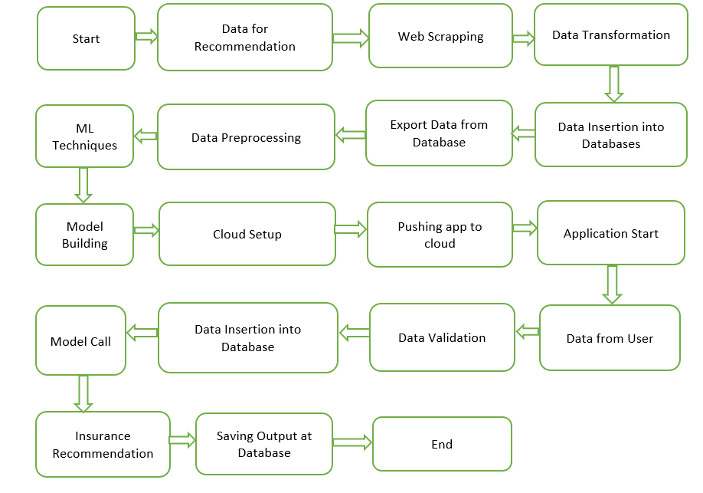
Architecture

Slide 6
Data Ingestion and Data Transformation
Data ingestion involves gathering and importing data for use in the project. This component handles collecting health data from various sources and storing it in a structured format.
Data transformation processes the raw data into a format suitable for analysis and modeling. This includes data cleaning, normalization, and feature engineering to enhance the predictive power of the model.

Slide 7
Model Trainer and Training Pipeline
The model trainer component is responsible for training machine learning models on the transformed data. It involves selecting appropriate algorithms, tuning hyperparameters, and validating model performance.
The training pipeline automates the workflow of data ingestion, data transformation, model training, and validation. It ensures that the entire process is repeatable and scalable.

Slide 8
Model Selection
For predicting insurance premiums based on individual health data, Linear Regression is identified as the most suitable model. Gradient Boosting Regression is an ensemble learning technique that builds models sequentially, each new model correcting errors made by previous models. It offers high accuracy, handles complex data relationships well, and is less prone to overfitting compared to other models. Scikit-Learns Linear Regression is utilized for this purpose, providing robust and interpretable predictions.

Slide 9
Predictions
The testing files are shared in the batches and we perform the same validation operations, data transformation and data insertion on them.
The accumulated data from db is exported in csv format for prediction
We perform data pre-processing techniques on it.
Once the prediction is done. The predictions are saved in csv format and shared.

Slide 10
Questions & Answers
What is the source of data?
https://www.kaggle.com/datasets/noordeen/insurance-premium-prediction
2. What is the data type of data?
The data is the combination of numerical, string and categorical values.
3. How logs are managed?
We are using different logs and we store them in local system as well as on MLFlow.

Slide 11
Questions & Answers
4. What techniques were you using for data pre-processing?
Removing unwanted attributes
Visualizing relation of independent variables with each other and output variables
Checking and changing Distribution of continuous values
Removing outliers
Cleaning data and imputing if null values are present.
Converting categorical data into numeric values.
Scaling the data

Slide 12
Questions & Answers
5. What are the different stages of deployment?
When the model is ready we deploy it on AWS, GCP, Azure or Render. Here I have deployed this model Render.
Once it gets deployed we get a URL and we can access the URL which redirect us on the prediction model where we can perform the prediction.

Slide 13
More questions about Insurance Premium Prediction?
Contact On Below:
mailto:rohitshrimangle02@gmai.com
https://www.linkedin.com/in/rohit-shrimangle-b7a925242/
https://www.kaggle.com/datasets/noordeen/insurance-premium-prediction

